Slide 1


MIFIRA Framework
Lecture 9
Competition: supply chains
Chris Barrett and Erin Lentz
February 2012

Slide 2
Linking Supply Chains to Competition
Marketing cost (gross per unit profit) = Retail price – farm-gate price
Marketing margins are costs of equipment, transport, labor, capital, risk, and management
In long run, marketing margins for competitive markets should be equivalent to the cost of marketing

Slide 3
Linking Supply Chains to Competition
In a competitive market, each market actor takes prices as given
Long-run equilibrium implies zero “pure” profit
  all factors of production receive their market price
  if excess profits exist, more agents would enter the market
  Use supply chains and marketing margins to examine whether profits appear excessive
    if profits are excessive in any link (or segment) in the supply chain, then that link is not competitive

Slide 4
Elements of Competitive Markets
Fungibility and divisibility of commodities
Buyers and sellers are rational actors
Firms are small, numerous
No barriers to entry
Complete knowledge of supply and demand forces
Or:
Consumers and producers act as price takers

Slide 5
Supply Chains: Step 1
Identifying actors and number of links in supply chains are first step in computing marketing margins
  Key informants
  Trader interviews
Not all segments are equally competitive (Barrett 1997)
  Focus on those segments meeting fewest competitive elements

Slide 6
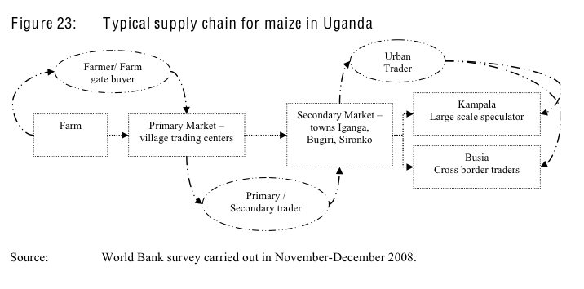
Example: Supply Chain for Maize in Uganda
Source: World Bank – Agriculture and Rural Development Sustainable Development Network (2009) “Eastern Africa: A Study of the Regional Maize Market and Marketing Costs.” World Bank. Report No. 49831 - AFTAR.

Slide 7
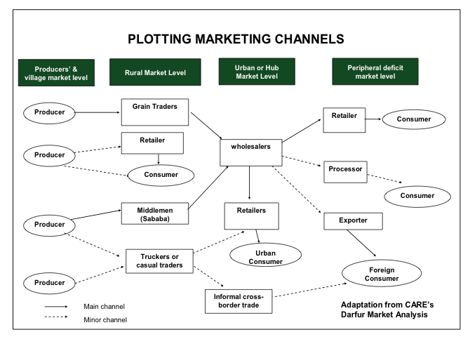
Example: Supply Chain in Sudan from FEWs (2009; Lesson 2, p. 25)

Slide 8
Identify Actors
Speak with major traders operating in local markets in food insecure areas
Ask traders:
  From whom and where do they buy?
    How many suppliers do they have?
  To whom and where do they sell?
    How many customers do they have?
  At what prices? On what dates?
Sometimes called parallel or channel surveys

Slide 9
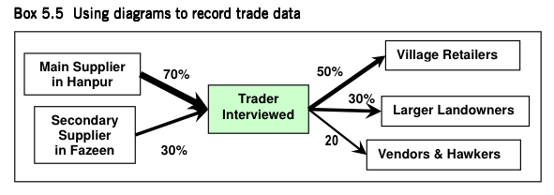
Recording Trader Linkages
(from EMMA)
Source: Albu (2010) Emergency Market Mapping and Analysis Toolkit

Slide 10
Categorize Actors (Step 2)
Speak with traders buying from and selling to the traders operating in the food insecure area
Categorize traders based on:
  Typical supply routes
  Who they sell to and who they buy from
  Monthly volumes of sale
  Types of transport they own or have access to
  Credit they can leverage
  Food storage options
  Common constraints

Slide 11
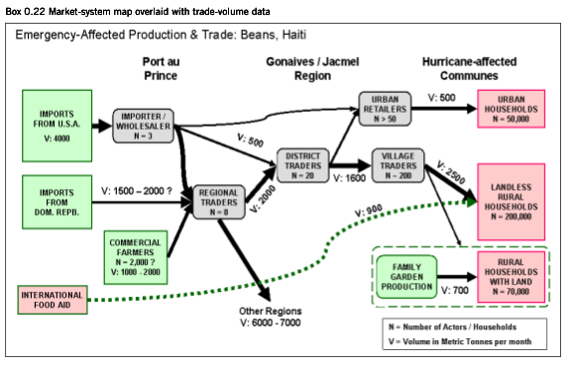
EMMA: Market System Map with volumes and trader counts
Source: Albu (2010) Emergency Market Mapping and Analysis Toolkit

Slide 12
Marketing Margins (Step 3)
Marketing Cost (Gross profit per unit) = Difference between purchase price and sales price (1)
Marketing margins are total costs per unit (2)
Decompose margins into cost elements
  Fixed costs
  Variable costs
  Apportion fixed costs to a commodity by revenue or volume
  Compute in absolute or percentage terms
  Does (1) = (2)?

Slide 13
Marketing margins: Example of Variable Costs
Average Costs on a Purchase Trip | KShs
Transport costs from your supplier to your business
Security Costs
Bribes
Loading / unloading if not done by your employee
Bagging
Losses
Other (specify):
Other (specify):
Average volume purchased

Slide 14
Marketing margins - Example of Fixed Costs
Monthly Costs | KShs
Rent
Extra storage costs
Labor
Average monthly fees (e.g., license, tax, council fees)
Communications
Vehicle maintenance
Security Costs
Bribes
Credit payments
Transformation / processing
Other costs:

Slide 15
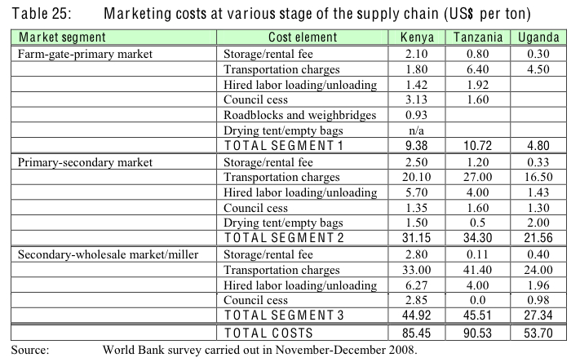
Marketing Margins
Source: World Bank – Agriculture and Rural Development Sustainable Development Network (2009) “Eastern Africa: A Study of the Regional Maize Market and Marketing Costs.” World Bank. Report No. 49831 - AFTAR.

Slide 16
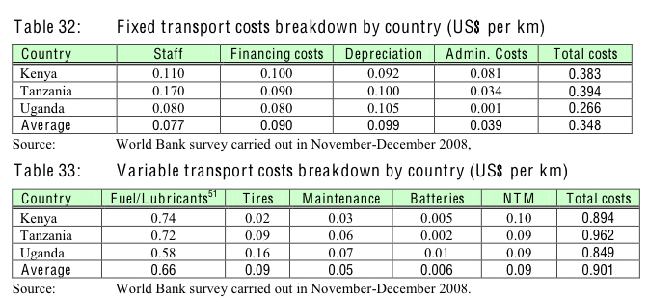
Transport Costs
Source: World Bank – Agriculture and Rural Development Sustainable Development Network (2009) “Eastern Africa: A Study of the Regional Maize Market and Marketing Costs.” World Bank. Report No. 49831 - AFTAR.

Slide 17
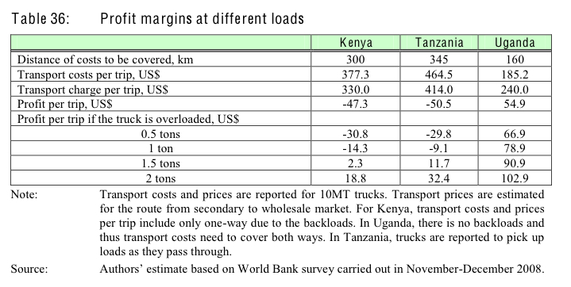
Transport Costs: Profit margins
Source: World Bank – Agriculture and Rural Development Sustainable Development Network (2009) “Eastern Africa: A Study of the Regional Maize Market and Marketing Costs.” World Bank. Report No. 49831 - AFTAR.

Slide 18
Supply Chain and Marketing Margins Limitations
Time intensive and sensitive for respondents
Margins may fluctuate
  exogenous factors
  by commodity
  by link within supply chains
See annotated trader survey from MIFIRA Uganda study for comments on eliciting supply chain information

